Slide 1
Opioids and Narcan in Montcalm County

Slide 2
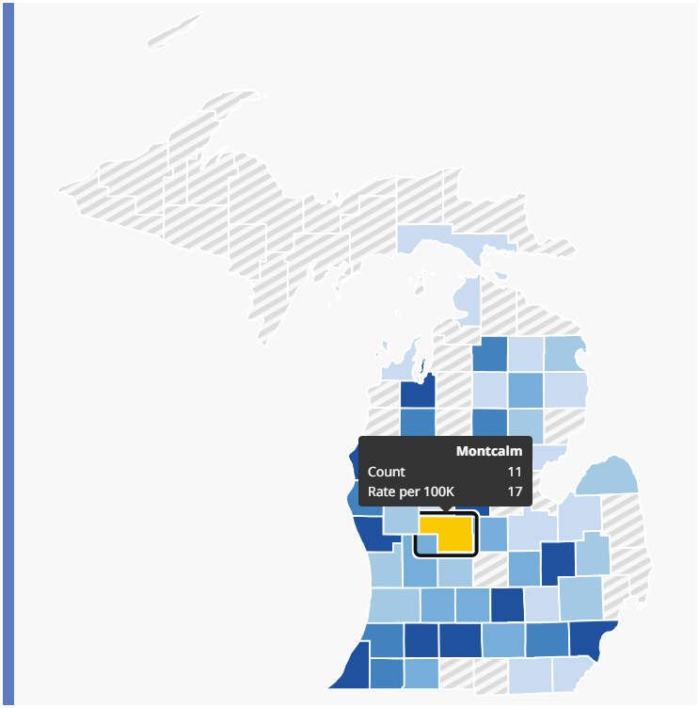
Opioid Overdoses 2023
1,800
Suspected fatal Overdoses* in Michigan
Jan 1, 2023 – Oct 26, 2023
*: as indicated by Medical Examiner reports for counties with available data
https://systemforoverdosesurveillance.com/

Slide 3
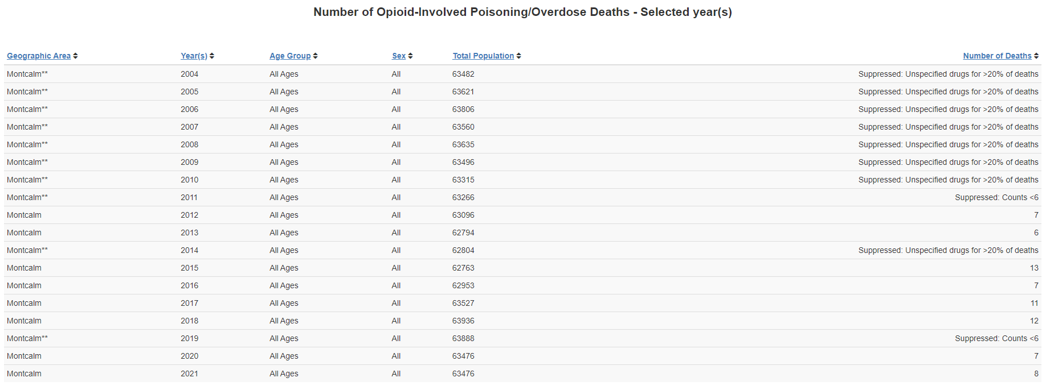
Overdose Deaths: 2004-2021
Retirement
Training and education
https://mitracking.state.mi.us/

Slide 4
Opioid Hospitalizations: 2016-2020
https://mitracking.state.mi.us/

Slide 5
Opioid Emergency Room Visits: 2018-2020
https://mitracking.state.mi.us/

Slide 6
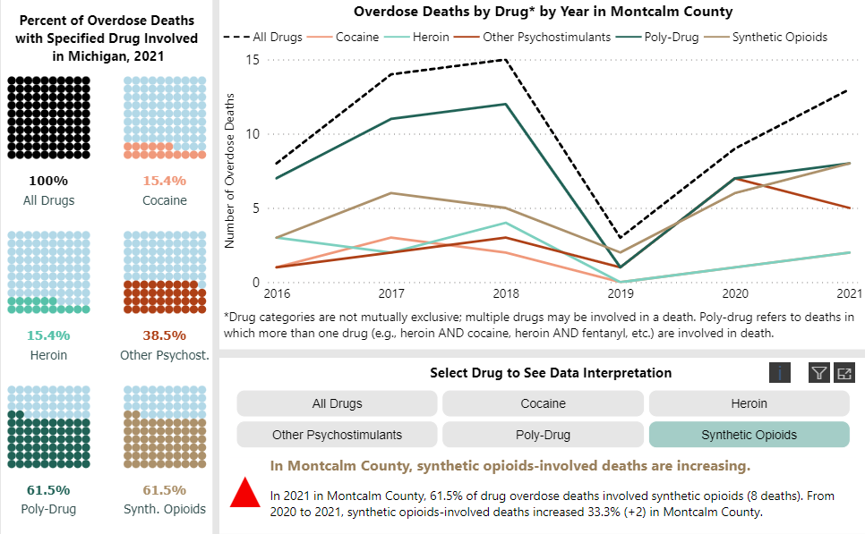
Overdose Deaths: 2016-2021
https://www.michigan.gov/opioids/category-data

Slide 7
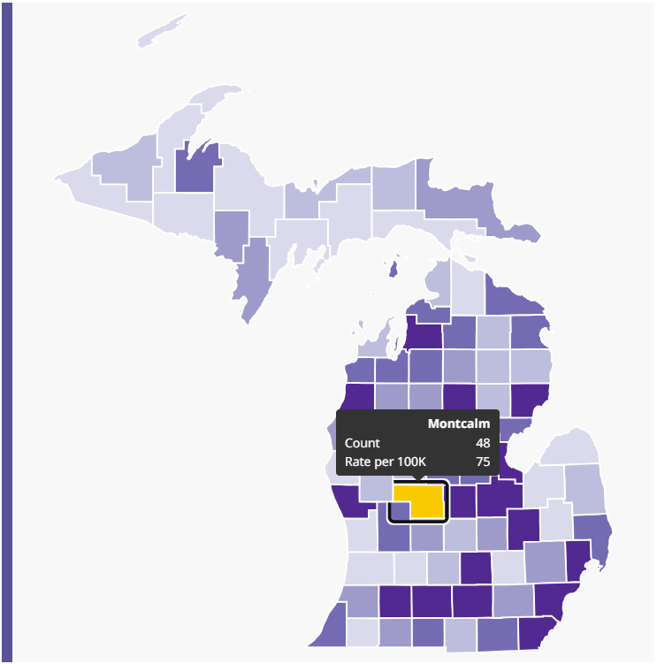
Narcan Administrations 2023
10,700
EMS Naloxone Administrations in Michigan
Jan 1, 2023 – Oct 26, 2023
https://systemforoverdosesurveillance.com/

